Slide 1

IMDB Movie Analysis

Slide 2

Project Description
IMDB Movie Analysis investigate a potential problem, “What factors influence the success of a movie on IMDB. Riposting to this problem is significant for movie producers, directors, and investors who want to understand what makes a movie successful to make informed decisions in their future projects.
Here, I will perform Exploratory Data Analysis in which I will investigate the dataset to discover patterns, outliers and generate statistical summary, create various graphical representations to understand the data.

Slide 3
Tech Stack Used
Ms Excel office 2016
A spreadsheet software where data can be stored in tabular format, cleaned and analysed to obtain meaningful insights for data-driven decisions.
For EXCEL FILE CLICK HERE
Ms PowerPoint 2016
A powerful presentation maker used to create slideshow of valuable information through charts, and images.

Slide 4

Approach
Ask:
What are Most common Genres of movies in the dataset?
Analysing the distribution of movie durations and what is the relationship between duration and IMDB scores?
What is the most common language used in movies? Analyze their impact on IMDB score.
What is the influence of directors on movie ratings?
Exploring the relationship between movie budgets and gross earrings. Name the movies with highest Profit Margin.

Slide 5
Prepare:
Collect the dataset on IMDB Movie Ratings.
This dataset have 28 columns and 5044 rows. But duplicate that dataset and delete the columns we don’t need for this analysis.
These required Columns are: director_name, duration, budget, gross, movie_title, language, country, IMDB_score, genres.
Save this file as .xlsx file.

Slide 6
Process: Cleaning the dataset
Removing duplicates: Here we will remove duplicated depending on movie_title but, the movie “The Host” & “ Out of the Blue” have same names but different attributes. So, except these rows all the other duplicates are removed. 124rows are removed.
Removing Columns: Only 10 out of 28 columns are required for our analysis so, 18 columns which is unnecessary data is removed.
Handling Missing Values: duration, language, country columns have less than 15 missing values so these are filled used data scrapping method i.e., a simple internet searching. Director_name, gross, budget have more than 100 missing values and these are removed.
Handling Outliers: There are several outliers in gross, budget fields but as it represents the monetary values and can’t have a specified limits, these should be handled with care during analysis.

Slide 7
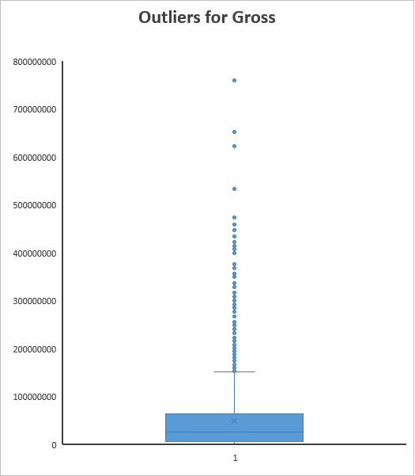
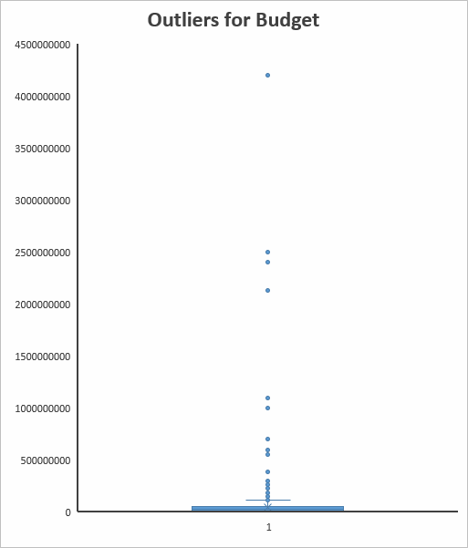

Slide 8
Analyze: The dataset is ready for analysis and named as cleaned_data,
Movie Genre Analysis: Determining the most common genres of the movies in the dataset.
Separating the genres to different columns by using data tool ‘text to columns’.
Using COUNTIF() and RANK.EQ() we will determine the most common genres of movies.
“Drama” followed by comedy, thriller, action and romance are top 5 common Genres.
Descriptive statistics is calculated by formulas MEDIAN(), AVERAGEIF(), VAR.P(),STDEV.P().

Slide 10
Insights:
Most common genre- DRAMA
Average IMDB score- 6.82
Median of IMDB score- 6.9
Most Frequently occurring score- 6.7
Variance is < other genres, score is less scattered from its mean.
Standard deviation < other genres (0.90)
Genre | Count | Max of IMDB Score | Min of IMDB Score | Mean of IMDB Score | Median of IMDB Score | Mode of IMDB Score | Range of IMDB Score | Variance of IMDB Score | S.D of IMDB Score
Drama | 1917 | 9.3 | 2.1 | 6.82 | 6.9 | 6.7 | 7.2 | 0.80 | 0.90
Comedy | 1496 | 8.8 | 1.9 | 6.17 | 6.3 | 6.7 | 6.9 | 1.09 | 1.04
Thriller | 1089 | 9 | 2.7 | 5.30 | 6.4 | 6.5 | 6.3 | 0.96 | 0.98
Action | 937 | 9.1 | 2.1 | 6.29 | 6.3 | 6.6 | 7 | 1.10 | 1.05
Romance | 872 | 8.5 | 2.1 | 6.13 | 6.5 | 6.5 | 6.4 | 0.95 | 0.98
Adventure | 766 | 8.9 | 2.3 | 6.56 | 6.6 | 6.6 | 6.6 | 1.25 | 1.12
Crime | 704 | 9.3 | 2.4 | 6.92 | 6.6 | 6.6 | 6.9 | 0.98 | 0.99
Fantasy | 496 | 8.9 | 2.2 | 6.23 | 6.4 | 6.7 | 6.7 | 1.30 | 1.14
Sci-Fi | 484 | 8.8 | 1.9 | 6.59 | 6.4 | 7 | 6.9 | 1.36 | 1.17
Family | 443 | 8.6 | 1.9 | 6.50 | 6.3 | 5.4 | 6.7 | 1.36 | 1.17

Slide 11
B. Movie Duration Analysis: Analysing the distribution of movie duration and its impact on the IMDB score. Scatter plot to show the relationship with a linear trendline.
Max of Duration | 330
Min of Duration | 34
Average Of Duration | 109.83
Median of Duration | 105
Mode of Duration | 105
Range of Duration | 296
Variance of Duration | 518.36
Standard Deviation of Duration | 22.77

Slide 12
Insights:
The Relation between movie durations and IMDB scores follows a positive association between them.
There trends to increase or decrease together.
But higher duration doesn’t mean it will have higher IMDB scores and vice versa.
Spread of data is high in durations as it contains outliers so, we use median to descried the data.
As per scatter plot, average duration movie trends to have IMDB score between 6 and 8.

Slide 13
C. Language Analysis: Determining the most common languages in the movies and analysing their impact on the IMDB scores.
Rank | Language | Count
1 | English | 3616
2 | French | 37
3 | Spanish | 26
4 | Mandarin | 14
5 | German | 13
6 | Japanese | 12
7 | Hindi | 11
8 | Cantonese | 8
9 | Italian | 7
10 | Korean | 5
11 | Portuguese | 5
12 | Norwegian | 4
13 | Danish | 3
14 | Dutch | 3
15 | Hebrew | 3
The most common languages are counted by using COUNTIF(), RANK.EQ() is used to Rank the languages from top to bottom. INDEX(MATCH()) to match the corresponding values.
95.2% of movies are in English as it the most used language in the world.
Followed by French, Spanish, Mandarin and German.
However, ratio of these languages is very low compared to English language.
Descriptive statistics of IMDB Scores based on languages is calculated using AVERAGEIF(), MEDIAN(IF()), MAX(IF()), MIN(IF()), VAR.P(), STDEV.P().

Slide 15
Language | Max of IMDB Score | Min of IMDB Score | Mean of IMDB Score | Median of IMDB Score | Mode of IMDB Score | Range of IMDB Score | Variance of IMDB Score | S.D of IMDB Score
English | 9.3 | 1.6 | 6.4 | 6.5 | 6.7 | 7.7 | 1.1 | 1.1
French | 8.4 | 5.8 | 7.3 | 7.2 | 7.2 | 2.6 | 0.3 | 0.6
Spanish | 8.2 | 5.2 | 7.1 | 7.2 | 7.2 | 3 | 0.7 | 0.8
Mandarin | 7.9 | 5.6 | 7.0 | 7.3 | 7.6 | 2.3 | 0.5 | 0.7
German | 8.5 | 6.1 | 7.7 | 7.7 | 7.4 | 2.4 | 0.4 | 0.6
Japanese | 8.7 | 6 | 7.6 | 7.8 | 0 | 2.7 | 0.7 | 0.9
Hindi | 8 | 2.8 | 6.4 | 6.9 | 0 | 5.2 | 2.3 | 1.5
Insights:
Maximum and Minimum IMDB score is for English language as there are more movies in English than any other languages.
The average IMDB score of these top languages is between 6.4 and 7.7.
These English movies belongs to U.S.A only as it is the top most country in film industry.
790-800 movies are made in U.S.A per year as per Statista.

Slide 16
D. Director Analysis: Identifying the top directors based on their average IMDB Score and analysing their contribution to the success of movies using percentile calculations.
Rank | Director | Count Of Movies | Average of IMDB Score | Percentile
1 | Charles Chaplin | 1 | 8.6 | 99.80%
2 | Tony Kaye | 1 | 8.6 | 99.80%
3 | Alfred Hitchcock | 1 | 8.5 | 99.60%
4 | Damien Chazelle | 1 | 8.5 | 99.60%
5 | Majid Majidi | 1 | 8.5 | 99.60%
6 | Ron Fricke | 1 | 8.5 | 99.60%
7 | Sergio Leone | 3 | 8.4 | 99.60%
8 | Christopher Nolan | 8 | 8.4 | 99.50%
9 | Asghar Farhadi | 1 | 8.4 | 99.30%
10 | Marius A. Markevicius | 1 | 8.4 | 99.30%
11 | Richard Marquand | 1 | 8.4 | 99.30%
12 | S.S. Rajamouli | 1 | 8.4 | 99.30%
13 | Billy Wilder | 1 | 8.3 | 99.00%
14 | Fritz Lang | 1 | 8.3 | 99.00%
15 | Lee Unkrich | 1 | 8.3 | 99.00%
16 | Lenny Abrahamson | 1 | 8.3 | 99.00%
17 | Pete Docter | 3 | 8.2 | 99.00%
18 | Hayao Miyazaki | 4 | 8.2 | 98.90%
19 | Quentin Tarantino | 8 | 8.2 | 98.90%
20 | Elia Kazan | 1 | 8.2 | 98.60%
Top directors based on their IMDB scores. Their percentile Ranks is calculated using PERCENTRANK.EXC().
Insights:
“Charles Chaplin” followed by “Tony Kaye” have highest average IMBD Score of 8.6 with only 1 movie.
About 99.80% better than other directors. All the 99.80% directors fall under this two directors.
Alfred Hitchcock, Damien Chazelle, Majid Majidi, Ron Fricke follow closely with 8.5 average IMDB score and 99.06% directors behind them.

Slide 17
E. Budget Analysis: Relationship Between Movie budgets and their financial success, analysing the correlation between them and identifying the movies with high profit margins.

Slide 18
Insights:
Profit Margin is calculated by =gross-budget. Some of the Values are negative which shows that movie is unsuccessful.
Movie with high profit margin is “Avatar” directed by James Cameron with average IMDB score of 7.9 in English.
Correlation coefficient between budget and gross is 0.2235 which is a positive correlation which indicates similar and identical relation between the two.
Avatar is closely followed by Jurassic World, Titanic, Star wars: Episode 4, The Extra Territorial and so on.
All these movies are in English and from U.S.A.

Slide 19
Insights
Most Common Genre - Drama
Average IMBD Score of Drama - 6.82
Most common score - 6.9
The spread of data is low in drama genre compared to others.
Drama, Comedy, Thriller, Action, Romance are likely genres which are most watched.
Positive association between movie durations and IMDB scores.
Higher durations doesn’t necessarily means high IMDB scores.
Average duration-105 minutes and this have wide spread of data as it have both the high and low IMDB values.
U.S.A is the largest producer of movies.
About 95.2% of movies are in English.
French, Spanish, Mandarin, German, Japanese and Hindi top most languages after English.

Slide 20
Charles Chaplin and Tony Kaye are the top most directors with average IMDB score 8.6 with a single movie.
99.80 percentile and other directors are below them.
4 more directors follow them closely at 8.5 average IMDB score with 99.60 percentile.
Correlation coefficient between budget and gross – 0.2235
Positive correlation.
Maximum profit – 523,505,847
Movie – Avatar
Director – James Cameron
IMDB score – 7.9
But highest IMDB score belongs to the movie “The Dark Knight” directed by Christopher Nolan with 9. It is in 9th position in terms profit.

Slide 21
Result
Factors that influence the IMDB ratings are
Which genre most popular among movies – Drama, Thriller, Comedy, Action and Romance.
In a common language most people can understand – English, Spanish.
Director names with high production qualities i.e., high budget will leave a lasting effect on the users.
Movie durations should be average i.e., not too long or too short.
Having high IMDB score is not always an indicator for a profitable movie but it can be a successful movie.

